Slide 1

Biomedical Graduate
Student Association

Slide 2
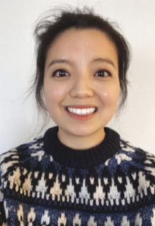
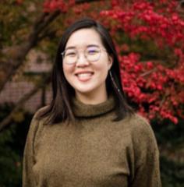
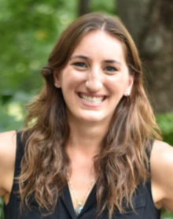
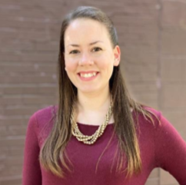
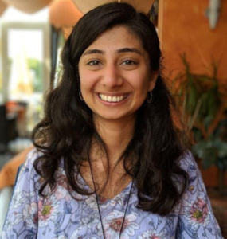
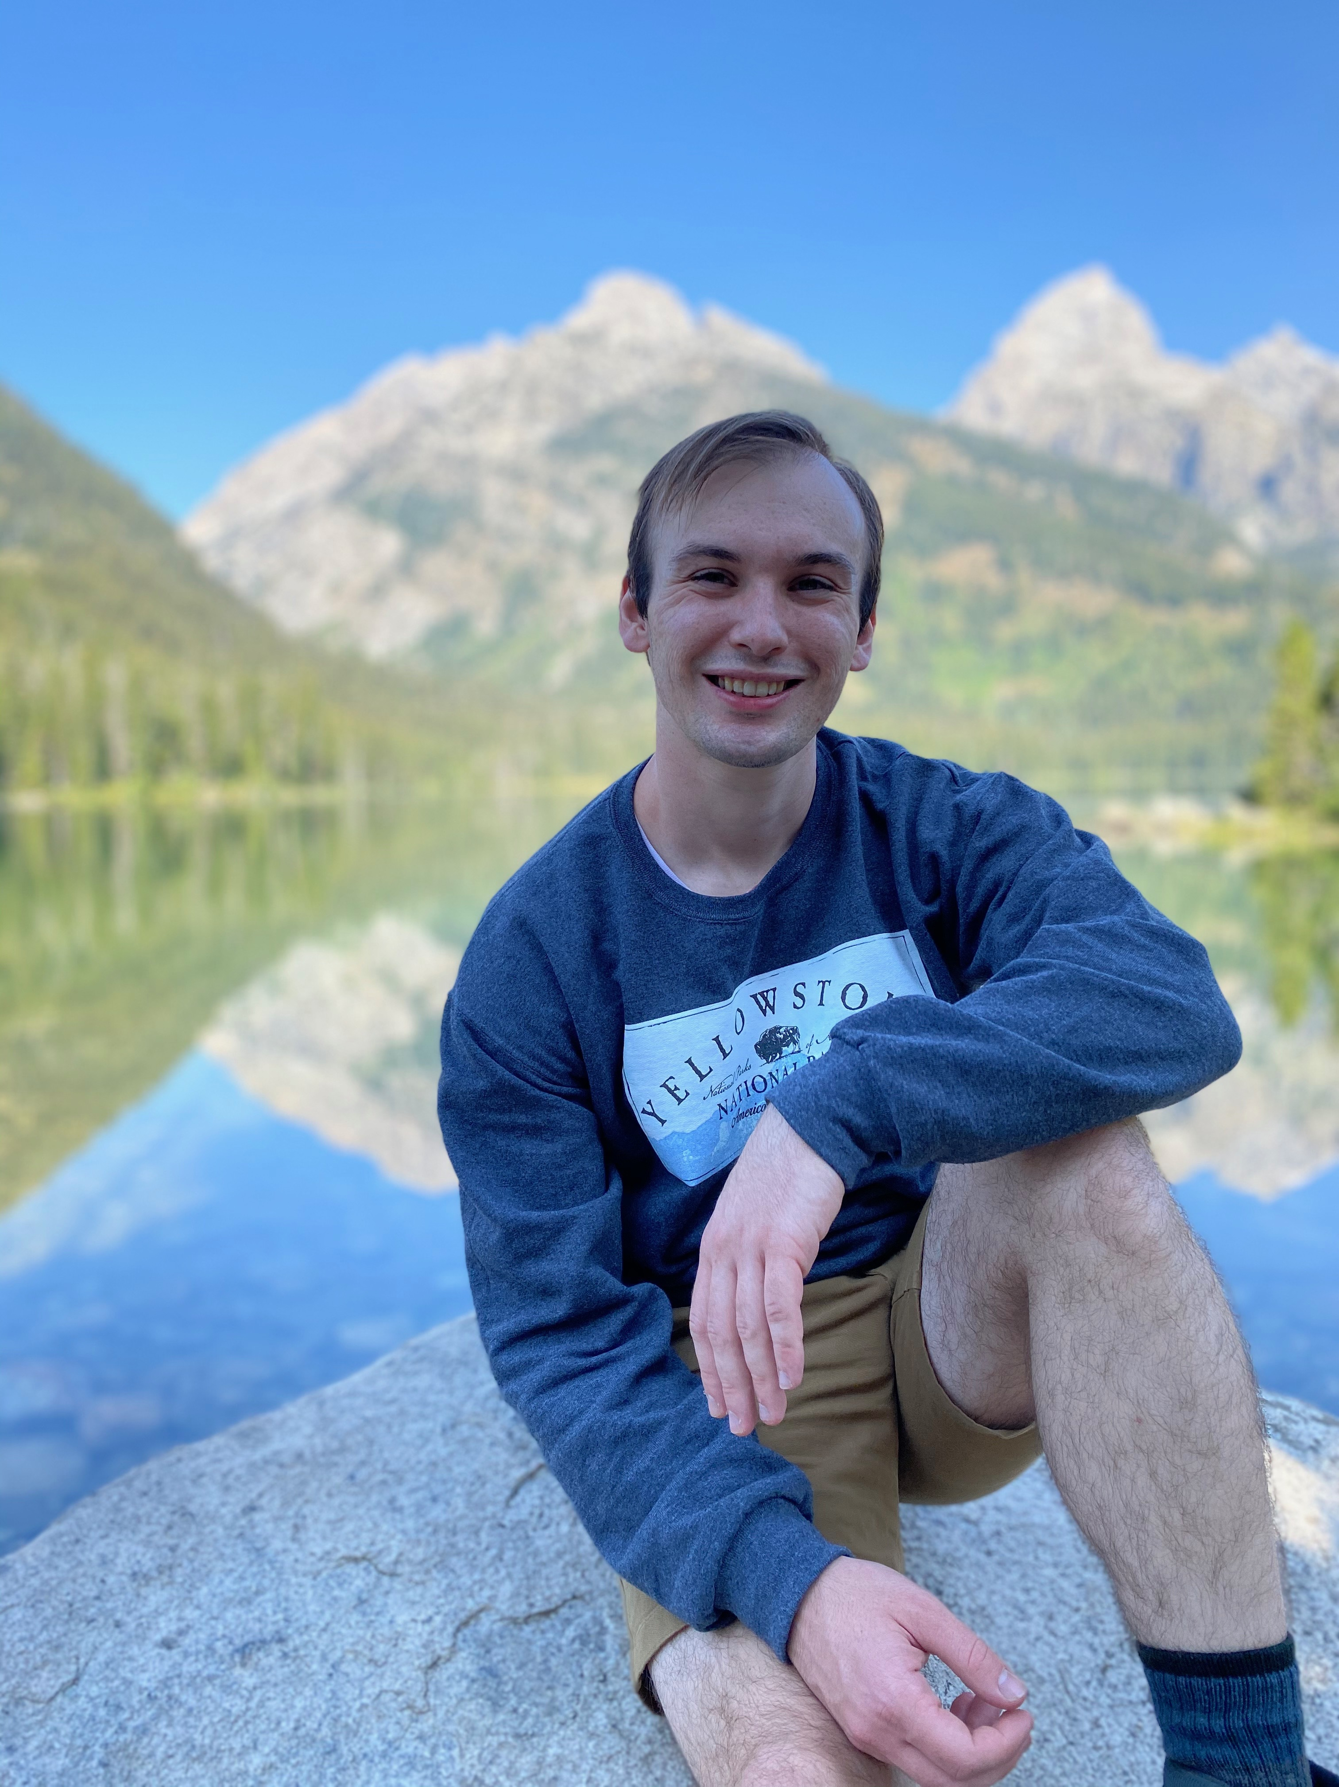
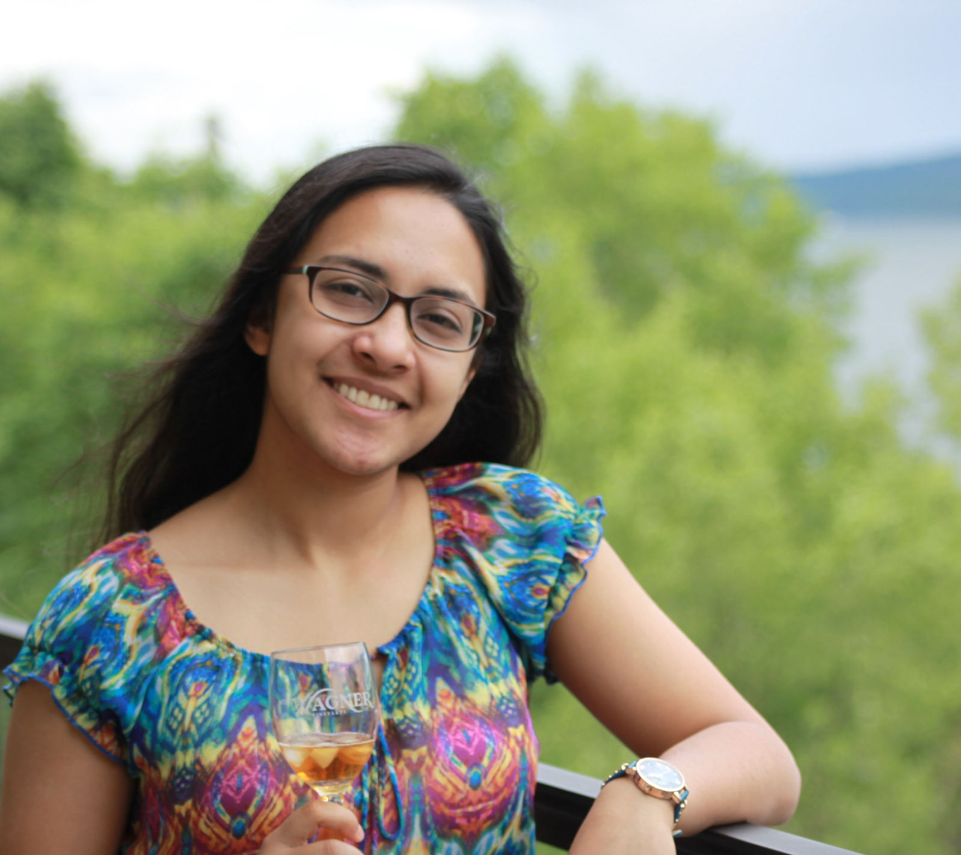
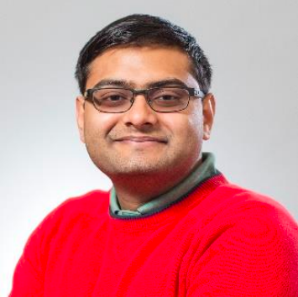
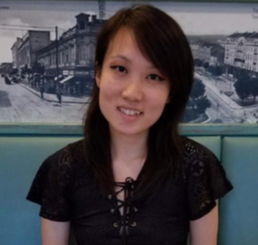
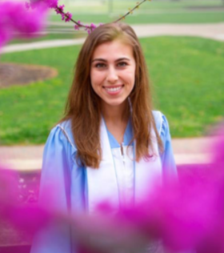
2021-2022 Executive Board
Chair: Rina Kim
Vice Chair: Carolyn Lou
Academic: Bernadette D’Alonzo
Finance: Sarah Hegarty
GAPSA Rep: Zeenat Diwan
Social: Priyanka Chatterjee
Social: Kuldeep Yadav
Operations: Nick Illenberger
Social Media: Angela Zhu
GAPSA Rep: Emily Getzen

Slide 3
What We Do
Funding
Career Panels
Advocacy
Social Events

Slide 4





Past Events

Slide 5
Get Involved
General Assembly Meetings: First Tuesdays of every month
First Meeting: September 7th, 5pm

Slide 6


Stay in Touch!
@PennBGSA
Website: https://www.med.upenn.edu/bgsa/
Email: bgsa.[role]@gmail.com chair ∙ vc ∙ finance ∙ academic ∙ social ∙ operations ∙ socialmedia ∙ gapsa.rep.1 ∙ gapsa.rep.2
Notes:
https://join.slack.com/t/upennbgs/shared_invite/zt-99ajnayf-ImKfg7ic5niiE1u3ksyl5g

